Slide 1
Module 3 Oracle SQL Analytic Functions
Lesson 1: Processing Model and Basic Syntax
Notes:
Welcome to Lesson 1 of Module 3 on SQL analytic functions
Opening question
What is a fundamental difference between the SQL subtotal operators and analytic functions?
New processing model for analytic functions

Slide 2
Lesson Objectives
Understand processing extension for analytic functions
Write SELECT statements using basic syntax elements (OVER and ORDER BY)
Reflect on the motivation for analytic function extensions
Notes:
Lesson 1 introduces analytic functions.
Analytic functions were a new feature in SQL:2003. Module 3 covers the Oracle syntax and implementation of analytic functions but other enterprise DBMSs provide similar syntax and implementation.

Slide 3
Business Intelligence Analysis
Top and worst performers
Trends
Quantitative contributions
Notes:
3
Perform additional analysis of aggregate results such as rank aggregate function results
Top and worst performing units
Store sales
Qualitative ranking
Trends:
Identifying changes between time periods
Need aggregate calculations in moving windows
Numeric contributions
Quantitative ranking
Cumulative distribution: top or bottom percentage threshold
Contribution to a whole: sales agent performance in commissions as part of total commissions

Slide 4
SELECT statement extensions
Difficult to write
Poor productivity
Poor performance
Notes:
Difficult to write
High skill level
Complex SELECT statements
Procedural coding
Poor productivity
Slow to develop BI applications
Multiple languages and tools involved
Poor performance
- Optimizing compilers cannot combine SELECT statements and procedural coding

Slide 5
Analytic Function versus Aggregate Function
Aggregate Function
Computes one value
Analytic Function
Computes multiple values
Calculated before analytic functions
Preserves number of rows in a group
Calculated after aggregate functions
Reduces group to a single row
Notes:
Analytic functions differ from aggregate functions although both operate on groups of rows. An analytic function computes multiple values for a group of rows, while an aggregate function computes a single value for a group of rows. Thus, an analytic function preserves the number of rows in a group of rows, while an aggregate function reduces a group of rows to a single row. Processing of analytic functions occurs after aggregate functions so a single SELECT statement can contain both aggregate functions and analytic functions.

Slide 6
Analytic Function Processing
Rows
FROM
Groups
GROUP BY
Analytic
Create partitions
WHERE
HAVING
Evaluate functions
Result
ORDER BY
Order partitions
SELECT
Notes:
Extension of SQL statement processing for analytic functions
Analytic function processing occurs after row and group processing to perform calculations of GROUP BY results
Analytic function processing involves organizing results into partitions, evaluating functions over partitions, and then ordering the partitions

Slide 7
Basic Syntax Elements
<AnalyticFunction> ([<column-list>]) OVER ( [ORDER BY <ordering>] )
Place in SELECT clause list
OVER clause identifies window (set of rows)
Ordering criteria for function evaluation
Examples
RANK() OVER
(ORDER BY ItemPrice) AS RankUnitPrice
RANK() OVER
(ORDER BY SUM(SalesDollar) ) AS RankSales
Notes:
Rank function indicates the relative position of a row among its partition.
Rank function does not have any arguments
ORDER BY clause indicates criteria for function calculation such as ranking
Indicates a criteria for analytic function
Rank rows by SUM(SalesDollar)
Order on row or aggregate expression (such as SUM(SalesDollars))
Optional but used for most analytic functions
Need GROUP BY when ordering on aggregate expression
Only one partition
the entire query result after grouping
No PARTITION BY keywords indicates a single partition (entire query result after grouping)

Slide 8
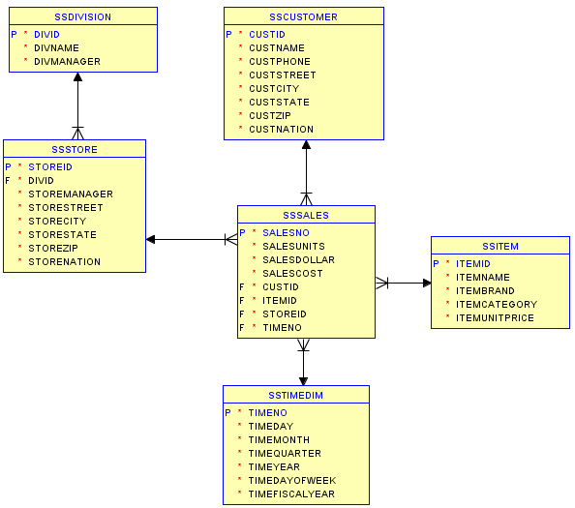
Oracle Diagram for the Store Sales Tables
Notes:
Used in slide examples and practice problems
Tables prefixed with SS (SSCustomer) in examples because of conflicting table names.
Typical query involves joins of fact and one or more dimension tables followed by grouping and aggregate function calculation

Slide 9
Rank Example I
Rank items by ascending item price
SELECT ItemId, ItemBrand, ItemUnitPrice,
RANK() OVER ( ORDER BY ItemUnitPrice ) AS RankUnitPrice
FROM SSItem;
ITEMID ITEMBRAND ITEMUNITPRICE RANKUNITPRICE
-------- ------------------ ------------- -------------
I1412138 Ethlite 12 1
I1445671 Intersafe 14.99 2
I6677900 Connex 25.69 3
…
Notes:
No grouping
Using a numeric column in the Item dimension table for the ranking
Descending order: largest SUM of salesdollar is first
Showing only partial results

Slide 10
Rank Example II
Rank customers by descending sum of dollar sales
Group on customer name
SELECT CustName, SUM(SalesDollar) AS SumSales,
RANK() OVER (ORDER BY SUM(SalesDollar) DESC) SalesRank
FROM SSSales, SSCustomer
WHERE SSSales.CustId = SSCustomer.CustId
GROUP BY CustName;
CUSTNAME SUMSALES SALESRANK
------------------------------ ---------- ----------
Sheri Gordon 556322 1
Wally Jones 94004 2
Jim Glussman 91100 3
Candy Kendall 90664 4
…
Notes:
GROUPING done first
Typical to group with a query involving dimension and fact tables
Summarize sales by customer name
Compute ranks over the set of groups
Typical for grouping when combining dimension and fact tables
Descending order: largest SUM of salesdollar is first
Showing only partial results

Slide 11
Additional Problems
Write SELECT statements
Example 3
Rank item brands descending by average dollar sales in 2014 and 2015
Show item brand, average dollar sales, and rank
Example 4
Rank item brands by average dollar sales in 2014 and 2015
Only include brands with more than 10 sales in 2014 and 2015
Show item brand, number of sales (COUNT), average dollar sales, and rank
Solutions in a module 3 document
Notes:
Use rank function
Grouping and non grouping

Slide 12
Summary
Use analytic functions to answer common business intelligence questions
Analytic functions computed after grouping
OVER and ORDER BY keywords
Notes:
Common business analysis questions
Best and worst performers: ranking
Performance over time: cumulative and moving functions
Relative contributions: cumulative distribution and report to ratio
Other functions
OVER keyword indicates analytic function evaluation
Optional PARTITION BY indicates sets of rows for function evaluation; all rows if omitted
ORDER BY clause indicates criteria for function evaluation
Computed after grouping
Somewhat confusing because grouping performs partitioning
Analytic functions often use GROUP BY results
Syntax somewhat confusing because analytic functions evaluated differently than other columns in SELECT clause
Useful to group before analytic functions for data warehouse queries involving dimension and fact tables
Partitioning
Optional: single partition (entire result table) if no PARTITION BY clause
Examples of rank and dense_rank functions shown
Relative number
Differ on ties
Rank leaves gaps after ties
Dense_rank leaves no gaps after ties

